Slide 1

Week 5
JINGYA LI

Slide 2
Outline
Unit 1 Quiz
Geoscience
Reading Text B
Summarizing

Slide 3
Unit 1 Quiz
contemplative fickle consummate forge discern
His experience makes him ideally suited to ______ partnerships all around the world.
Learn to observe all of life around you and you will begin to ______ the daily miracles that manifest all about you.
The media and the public can be very ______ and inconsistent on the issue of credibility.
We lead a ______ life, but that does not mean we sit in meditation all day long.
We are confident we can ______ a transaction quickly, confidentially and on the terms proposed.

Slide 4
Unit 1 Quiz
A writing technique that features a process.
A section that may attack the opposition
Content of the discussion and research
A fairly self-explanatory which usually follows deductive thought in terms of English language
An opening that states purpose and goals
An order of descending importance which is mostly used for listings.
Events that are arranged in the sequence in which they occur
A writing technique of grouping ideas, concepts, results, etc. according to their similarities and difference.
A summary of another source’s ideas
A section of an article describing other research on the topic in question
A method of persuasion

Slide 5
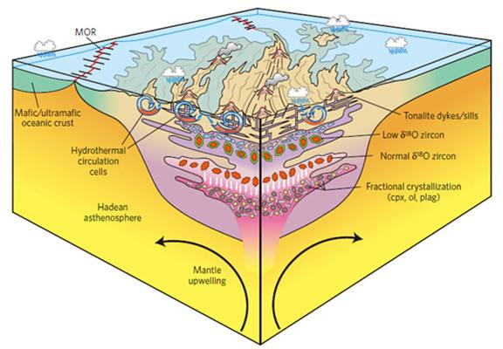
Geoscience

Slide 6
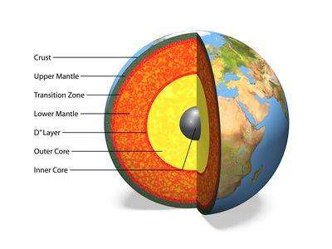
Hot Mantle
The mantle is the inner layer of terrestrial planet and other rocky planets.
The Earth's mantle is a roughly 1,800 mile (2,900 km) thick shell of compressed and heated rock, beginning below the Earth's crust.

Slide 7
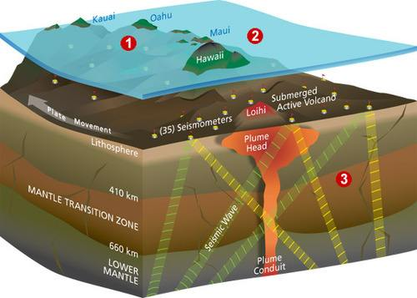
Hot Mantle Rising

Slide 8
The Mantle Plume
https://haokan.baidu.com/v?vid=2190686043347511048&pd=bjh&fr=bjhauthor&type=video
Notes:
How to form volcano through mental plume

Slide 9
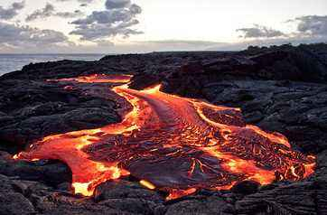
Lava
It is hot liquid rock that flows from a volcano.

Slide 10
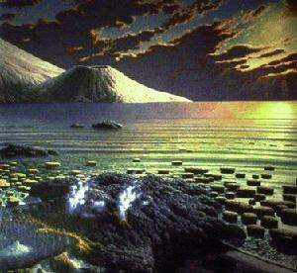
Archaean eon (太古宙)
A geologic eon that followed the Hadean Eon (冥古宙) and preceded the Proterozoic Eon (元古宙). During the Archaean eon, the earth’s crust had cooled enough to form continents.

Slide 11
Reading Text B: Hot Mantle Rising
Key findings:
The rarity of komatiite eruptions more recently in the earth’s history is taken as evidence of the mantle’s slow cooling.
The existence of such hot eruptions implies that mantle domains with Archaean-like temperatures are still formed or preserved in the deep earth.
The existence of such hot and relatively young lavas implies that regions of the earth’s mantle with extreme temperatures are still present, and that this heat can be preserved in ascending mantle plumes and drive melting and volcanism at the present day.

Slide 12
Academic Writing Skills
Summarizing

Slide 13
Summary VS. Paraphrasing
Summary:
Including the gist or main ideas
Excluding details and examples
Shorter than original text (about 1/3 of the original text)
Paraphrasing:
Maintain the meaning of the original text
Change the words or phrases
About the same length as the original text

Slide 14
True summary VS. Interpretive summary
True summary:
Including the main idea and primary supporting points of the original text
No comments or assessments of the original source
Interpretive summary
Including the argument of the original source and your comments

Slide 15
Skills for writing a summary
Read the original text carefully
Take notes
Source/citations
Main idea (use your own words)
Important supporting points

Slide 16
Skills for writing a summary
Structure
(One-paragraph summary)
Main idea + in-text citation
1 sentence for each supporting point
1-2 explanations for each supporting point
Structure
(Multi-paragraph summary)
Para. 1: Main idea + in-text citation
Para. 2: Supporting point 1 (as topic sentence) + explanations
Para. 3: Supporting point 2 (as topic sentence) + explanations

Slide 17
Skills for writing a summary
USE YOU OWN WORDS
Use transitional words and expressions
Acknowledge the source of original text
Integral citation
Non-integral citation

Slide 18
Integral citation
Tend to give greater prominence to the cited author.
Carroll (2002: 11) claims that it is necessary to spend time clarifying the definition of plagiarism because it is often wrongly used by students “to describe all academic dishonesty”.

Slide 19
Non-integral citation
Tend to give greater prominence to the cited content
It is necessary to spend time clarifying the definition of plagiarism, because it is often wrongly used by students “to describe all academic dishonesty” (Carroll, 2002: 11)

Slide 20
Language conventions for writing a summary
Use reporting verbs
Reporting verbs can indicate:
The author’s personal view point;
Your viewpoint regarding what the author says;
The author’s viewpoint regarding other literature.

Slide 21
Three reasons of using reporting verbs
What other writers did in their research
survey, analyze, examine, explore
Past tense in general
What other writers found in their research
find, establish, show, hint
Past/present tense
What other writers thought or said in their writing
propose, explain, claim, argue
Present tense in general

Slide 22
Reporting verbs
1. neutral verb choices:
According to
Acknowledge
Comment
Define
Describe
Discuss
Note
Point out
state

Slide 23
Reporting verbs
2. verbs that indicate an author’s position:
Allege, argue, assert, challenge, claim, concede, defend, doubt, emphasize, endorse, take issue with, maintain, put forward, recommend, reject, refute, suggest, support

Slide 24
Reporting verbs
3. verbs that indicate an author’s thinking
Assume, believe, consider, hypothesize, predict, recognize, take for granted

Slide 25
Reporting verbs
4. verbs that indicate an author is showing something
Demonstrate, explain, illustrate, indicate, present, show

Slide 26
Reporting verbs
5. verbs that indicate an author is proving something
Confirm, establish, prove, substantiate, validate, verify

Slide 27
Reporting verbs
6. verbs that indicate what an author did
Analyze, apply, estimate, evaluate, examine, find, investigate, observe, study

Slide 28
Dictogloss
Listen to the recording and summarize what the speaker says.
The speakers: Smith (2003)
First listening: understand the main idea
Second listening: add supporting points
Refine your notes with your own comments
Structure for one-paragraph summary
Main idea
Supporting point
Explanations/comments

Slide 29
Dictogloss
Group discussion
Using the sentence structure on Page 41.
Smith (2003) argues that
According to Smith (2003)…
Select 3 groups to write down their summary on board
Each group vote which one you think is the best
Smith (2003) argues that unhappy people prefer to pursue things that make them happy but never find one. For example, they may not satisfied with their appearance, jobs or living conditions and want to make a change.

Slide 30
Task 1
A
A
C

Slide 31
Task 2
by Quan Zhou and his colleagues.
According to MacDonald and his collegues,
Ying Zhou’s findings
Nelson and Grand

